Slide 1
Smart Parking Lot
2E3

Slide 2
Technologies and components used
Frontend:
Backend:
Database:
React.js
Tailwind CSS
Google Maps API
Spring Framework
JWT for Authentication
PostgreSql
Arduino:
Python Libraries:
Additional Components:
Arduino microcontroller
Picamera2 library
RPi.GPIO library
Requests
Subprocess
Socket
RaspberryPi

Slide 3
Key Features

Slide 4
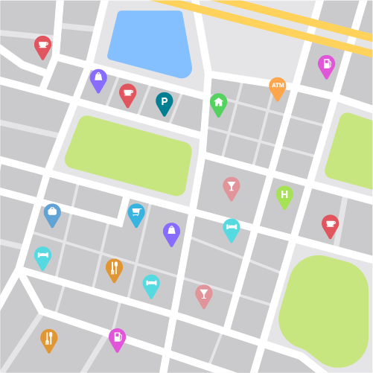
Real-time Spot Availability Updates + Payment Processing for Reservations
Spot Search and Reservation
Secure User Registration and Authentication
Integration with Google Maps API

Slide 5
Spot Search and Reservation:
Users can search for available parking spots based on location, price and other criteria.
Reservation functionality allows users to book parking spots in advance, ensuring availability upon arrival.
Auto-reserving, option that allows to automatically secure the nearest available spot based on user preferences.
Real-time Spot Availability Updates:
The backend continuously monitors parking spot availability and updates the frontend in real-time.
Users receive instant notifications about spot availability changes, ensuring they have the latest information.
Integration with Google Maps API:
The application integrates with the Google Maps API to provide accurate location data and navigation assistance to users.
Users can view parking spot locations on a map and receive directions to their selected spot, as well as the nearest one.

Slide 6
Payment Processing for Reservations:
The backend facilitates secure payment processing for parking reservations, supporting various payment methods such as credit/debit cards and mobile wallets.
Users can complete their reservation payments seamlessly within the application.
Secure User Registration and Authentication:
The backend manages user registration and authentication securely, using encryption techniques to protect sensitive data.
User authentication ensures that only authorized users can access the application's features.

Slide 7


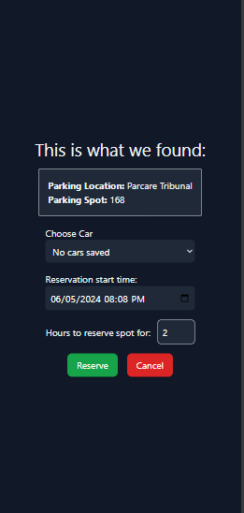
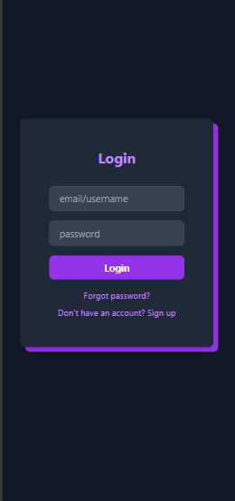
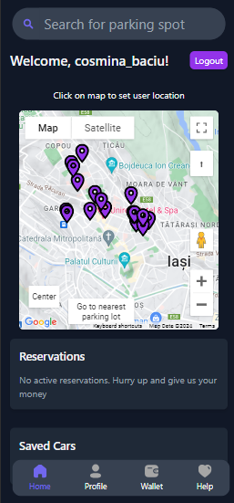
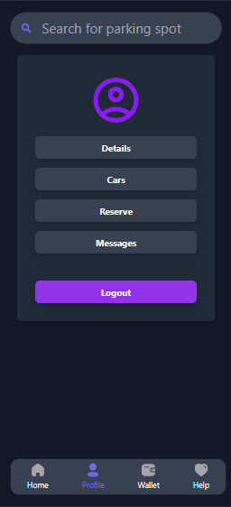
Application Workflow
User registration/login
Spot search and selection
Reservation and payment

Slide 8
Admin Panel Features
User Management
View all registered users.
Search for specific users.
Ban users to prevent them from accessing the service.
Parking Lot Management
View and edit parking lots.
Add, edit, or remove parking spots.
Update parking lot details like name and pricing.
Support Management
Access and manage user questions via Live Chat.
Manage support tickets through the Helpdesk system.

Slide 9
Backend Development Plan
User Registration: Implementation of user registration functionality allowing users to create accounts with their email addresses and passwords. + User input validation, password hashing, and storage of user credentials in the database.
Authentication: Secure authentication mechanisms using JWT (JSON Web Tokens) to generate and verify authentication tokens.
Signal Reception: Integration with Arduino-based parking sensors to receive occupancy signals via HTTP requests or MQTT messaging protocol.
Signal Processing: Algorithms to process incoming signals and update the database with real-time spot availability information.

Slide 10
API Integration: Integration with Google Maps API for location-based services, including geocoding, reverse geocoding, and directions.
Route Calculation: Utilization of the API to calculate and offer optimal routes from the user's location to the selected parking spot or to the nearest spot available.
Proximity-Based Recommendations: Suggests the nearest available parking spot dynamically.
Reservation Handling: Creation of API endpoints to handle spot reservations, including validation, confirmation, and cancellation.
Auto-Reserve: Automatically reserves the nearest available spot based on user preferences.
Payment Processing: Integration with payment gateways to securely process reservation payments using various methods (credit/debit cards, mobile wallets, etc.).

Slide 11
Arduino Component
Hardware Setup: Deployment of Arduino-based parking sensors in designated parking spots, equipped with sensors to detect vehicle presence.
Signal Transmission: Transmission of occupancy signals from Arduino sensors to the backend server using HTTP requests or MQTT messaging protocol.
Data Processing: Processing of incoming signals by the backend to update the database with real-time spot occupancy information.
Integration with Backend: Seamless integration with the backend system to ensure synchronization of spot occupancy data and timely updates for users.

Slide 12

Thank you for your attention!

